Slide 1






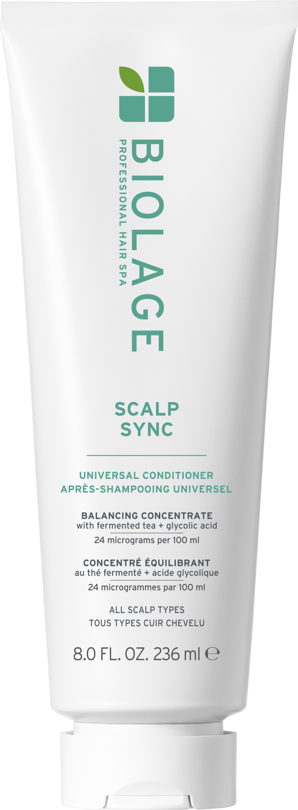

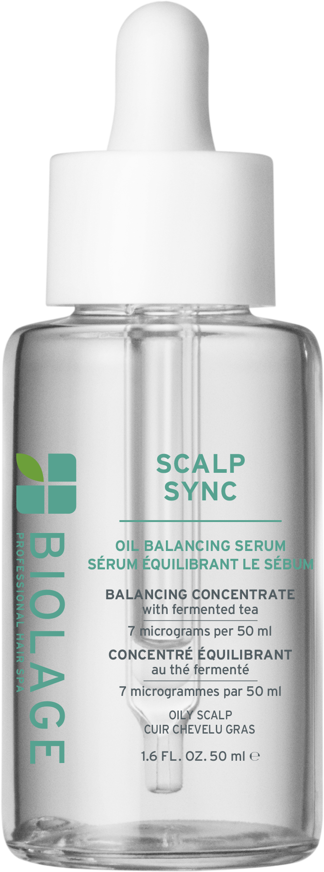

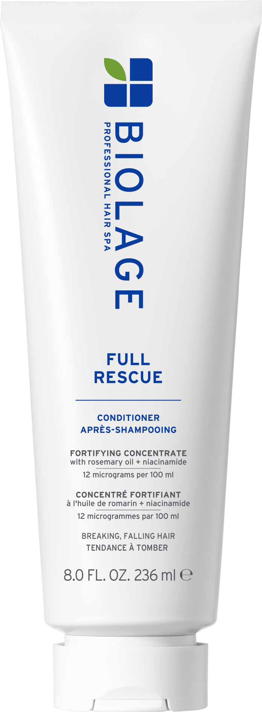




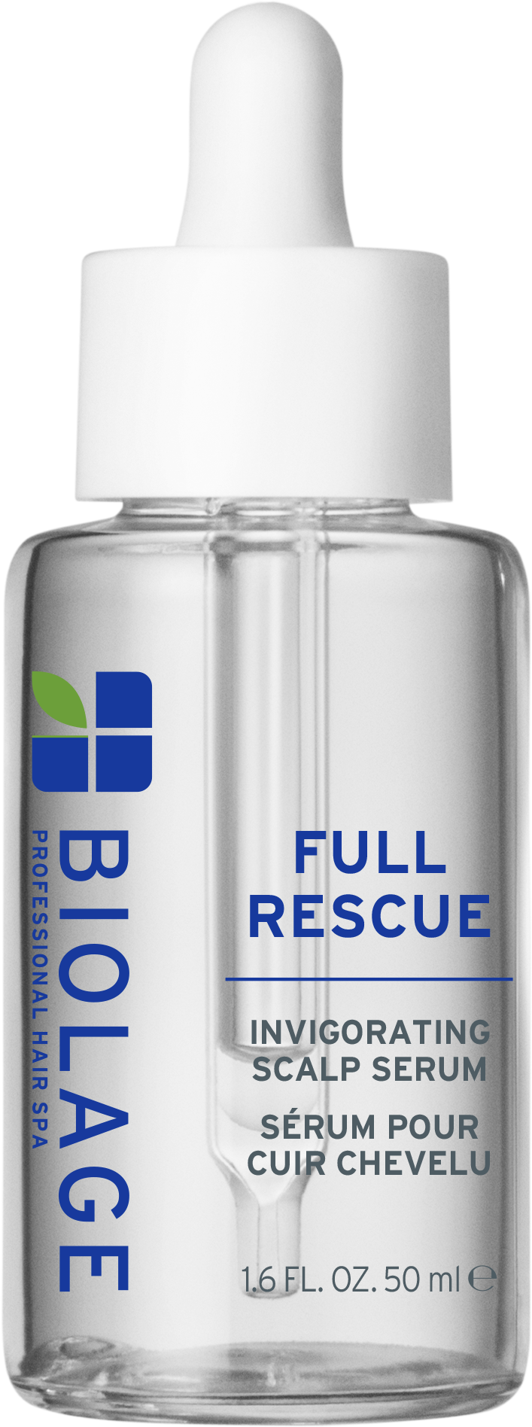


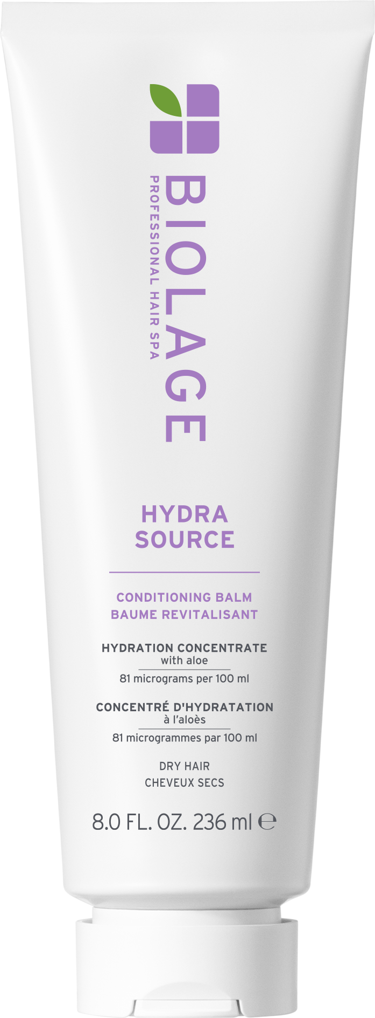

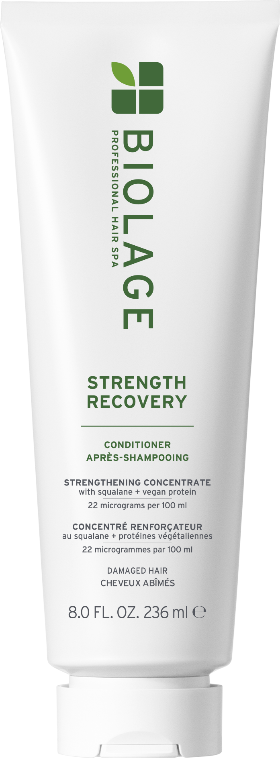
















Retail Wall (Biolage)
Small: 2ft W x 5 shelves
Medium: 3ft W x 5 shelves

Slide 2
Retail Wall (Biolage)
Large: 4ft W x 5 shelves
Floating Shelves: 3ft W x 2 shelves

